Slide 1
ABA BANK

Slide 2
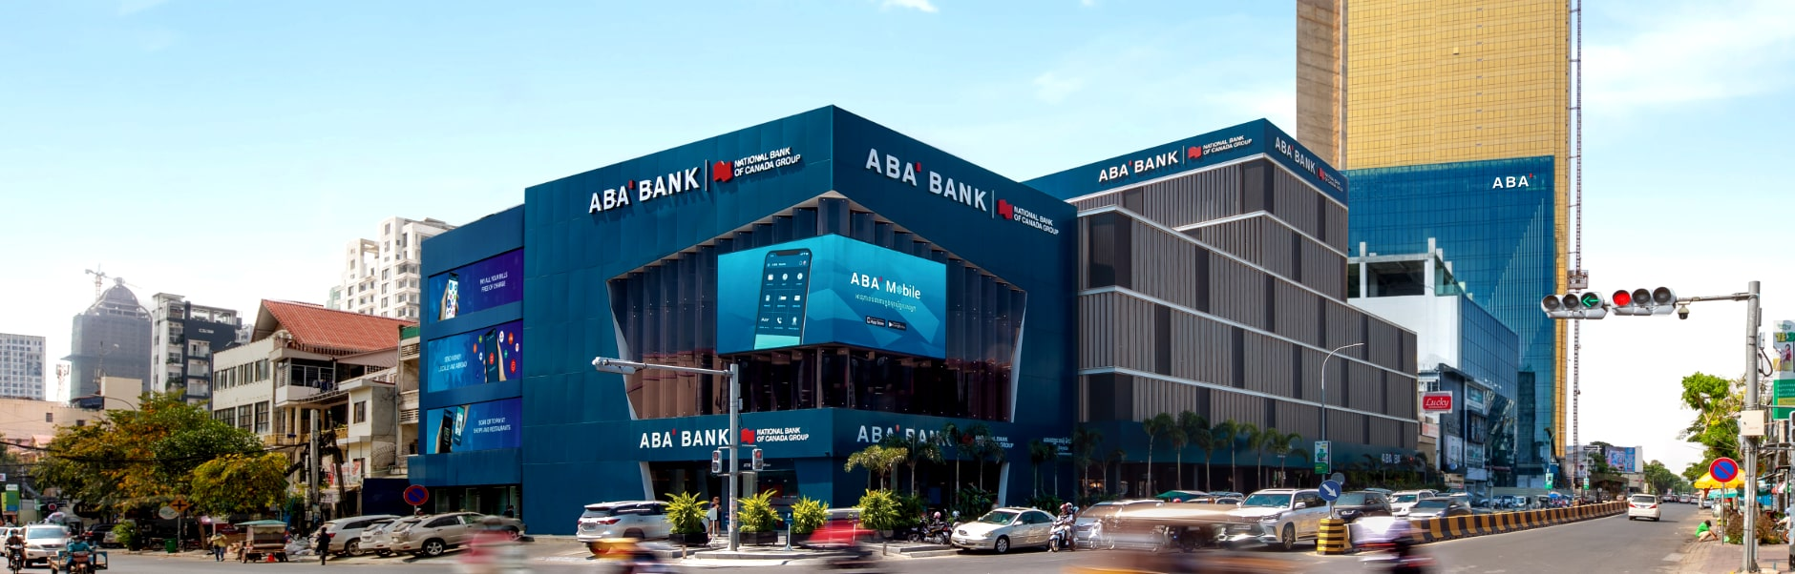
ABA BANK
Cambodia's premier private financial institution

Slide 3
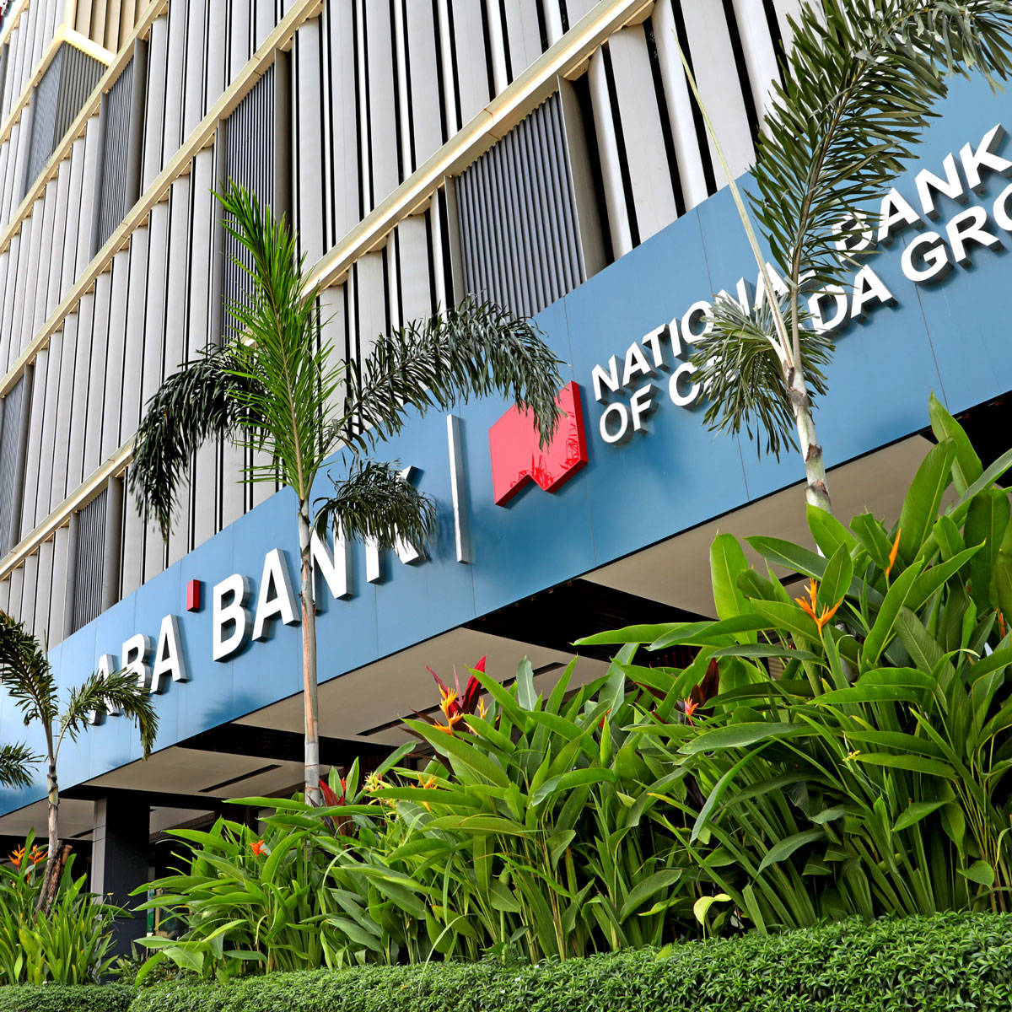
ABA Established in 1996 as the Advanced Bank of Asia Limited, we have become Cambodia's largest commercial bank by assets, deposits, loans, and profitability, according to the Annual Supervision Report 2021 of the National Bank of Cambodia

Slide 4

service
Competition
Missions and values
Future prospect
Market target

Slide 5
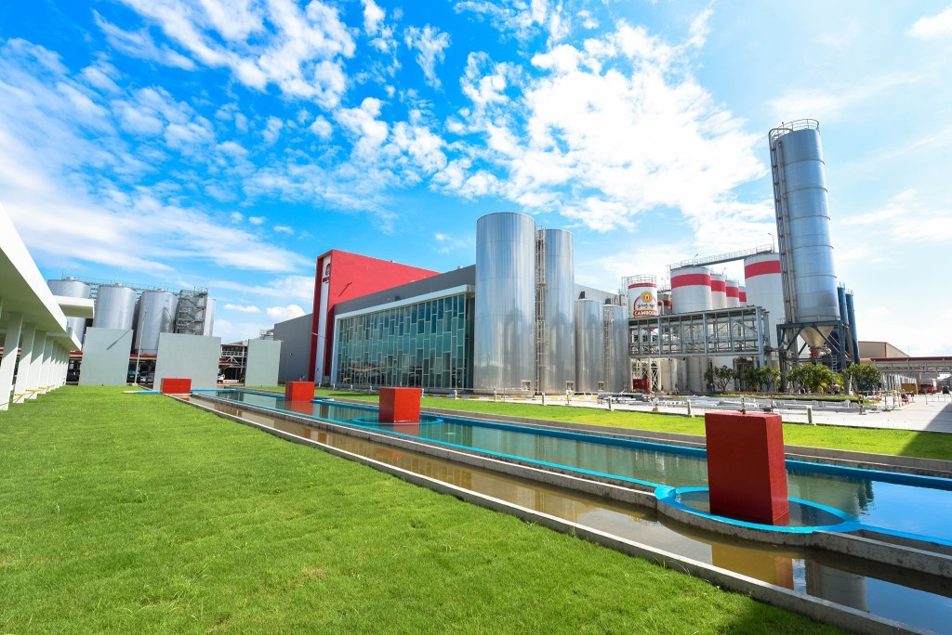
Khmer Beverages
Khmer Beverages (KHB) is Cambodia's leading producer of alcoholic and non-alcoholic beverages, 100% owned by Cambodian investors.
Khmer Beverages (KHB) is Cambodia's leading producer of alcoholic and non-alcoholic beverages, 100% owned by Cambodian investors.

Slide 6

About Khmer Beverages
Khmer Beverages is one of Chip Mong Group's business units. Founded in 2009, Khmer Beverages is a leading producer of alcoholic and non-alcoholic beverages.

Slide 7

Future prospect
Pruduct
Competition
Market target
Missions and values

Slide 8
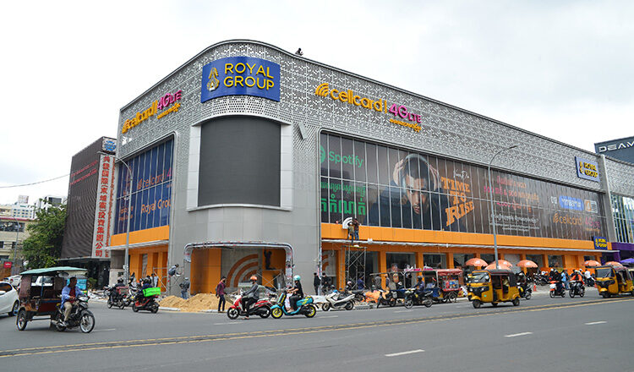
Cellcard
Aunched in 1997, Cellcard is Cambodia's longest-serving and only 100% Cambodian-owned operator, reputed for its long history of first-to-market innovations

Slide 9

About Cellcard
Cellcard is a Cambodian-owned and operated mobile telecommunications operator, a category pioneer with over 20 years of service, and currently one of the biggest operators in the Kingdom.

Slide 10

Missions and values
Competition
service
Market target
Future prospect

